Slide 1
Welcome to
FRS102 Symposium
23 JUNE 2016
Manchester Conference Centre
Summer School 2016

Slide 2
F
FRS102 Symposium
23 JUNE 2016
Manchester Conference Centre
Summer School 2016

Slide 3
R
FRS102 Symposium
23 JUNE 2016
Manchester Conference Centre
Summer School 2016

Slide 4
S
FRS102 Symposium
23 JUNE 2016
Manchester Conference Centre
Summer School 2016

Slide 5
1
Challenge
FRS102 Symposium
23 JUNE 2016
Manchester Conference Centre
Summer School 2016

Slide 6
0
Problems
FRS102 Symposium
23 JUNE 2016
Manchester Conference Centre
Summer School 2016

Slide 7
2
Solutions
FRS102 Symposium
23 JUNE 2016
Manchester Conference Centre
Summer School 2016

Slide 8
FRS102 Symposium
23 JUNE 2016
Manchester Conference Centre
Summer School 2016

Slide 9
Getting ready for FRS102?
Curtains Too the SQL was delivered with the Kesho Coding Plan.
The Kesho Coding Plan is ordered according to the Companies Act 1985/1989 format.
The current financial year-end accounts must be presented to the FRS102 standard.
FRS102 Symposium
23 JUNE 2016
Manchester Conference Centre
Summer School 2016

Slide 10
Fixed assets
1985 1989 Companies Act Format
Current assets
FRS102 Symposium
23 JUNE 2016
Manchester Conference Centre
Liabilities
Summer School 2016

Slide 11
Revenue account
1985 1989
Companies Act Format
Balance sheet
1985 1989
Companies Act Format
FRS102 Symposium
23 JUNE 2016
Manchester Conference Centre
Summer School 2016

Slide 12
Revenue account
1985 1989
Companies Act Format
FRS102 Symposium
23 JUNE 2016
Manchester Conference Centre
Summer School 2016

Slide 13
Getting ready for FRS102?
Kesho has developed two solutions to assist with the transition to the FRS102 standard.
The first involves re-ordering the nominal ledger accounts.
An almost impossible task if the credit union were to attempt to do this manually.
FRS102 Symposium
23 JUNE 2016
Manchester Conference Centre
Summer School 2016

Slide 14
Getting ready for FRS102?
The Kesho Coding Plan has been revised in the order required under FRS102.
An Excel spreadsheet has been produced to illustrate this.
The same spreadsheet will be used to map existing nominal codes to FRS102.
FRS102 Symposium
23 JUNE 2016
Manchester Conference Centre
Summer School 2016

Slide 15
FRS102 Symposium
23 JUNE 2016
Manchester Conference Centre
Summer School 2016

Slide 16
Getting ready for FRS102?
To utilise this method of converting the existing nominal ledger.
Download the spreadsheet from Kesho’s website www.kesho.co.uk.
Click ‘Curtains Too’ then click ‘FRS102 Mapping template’.
FRS102 Symposium
23 JUNE 2016
Manchester Conference Centre
Summer School 2016

Slide 17
Getting ready for FRS102?
Download the spreadsheet to a sensible location for ease of access later.
Using a coding plan and/or trial balance record your existing codes in column C.
Repeat this for all nominal codes you have used previously.
FRS102 Symposium
23 JUNE 2016
Manchester Conference Centre
Summer School 2016

Slide 18
Getting ready for FRS102?
Before conversion, ensure you have no uncleared audit reports.
Ensure all users are out of Curtains.
Ensure a backup is made of your Curtains databases.
FRS102 Symposium
23 JUNE 2016
Manchester Conference Centre
Summer School 2016

Slide 19
Getting ready for FRS102?
Maintenance.
Nominal
Account maintenance
FRS102 Symposium
23 JUNE 2016
Manchester Conference Centre
Summer School 2016

Slide 20
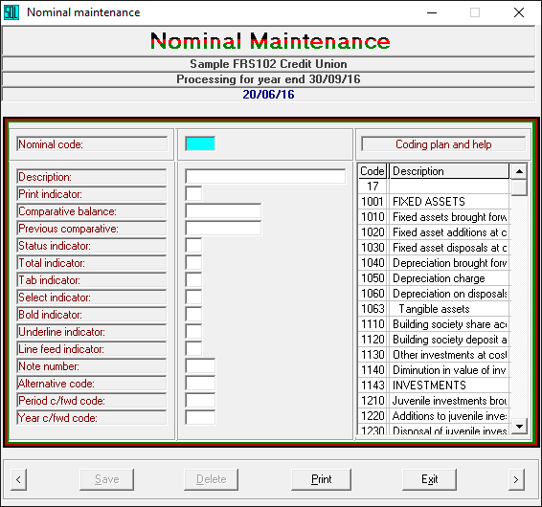
Getting ready for FRS102?
FRS102 Symposium
23 JUNE 2016
Manchester Conference Centre
Summer School 2016

Slide 21
Getting ready for FRS102?
FRS102 Symposium
23 JUNE 2016
Manchester Conference Centre
Summer School 2016

Slide 22
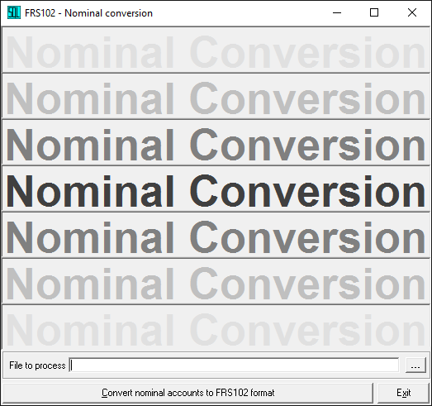
Getting ready for FRS102?
FRS102 Symposium
23 JUNE 2016
Manchester Conference Centre
Summer School 2016

Slide 23
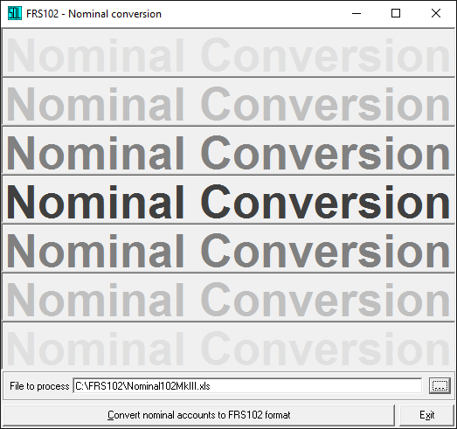
Getting ready for FRS102?
FRS102 Symposium
23 JUNE 2016
Manchester Conference Centre
Summer School 2016

Slide 24
Getting ready for FRS102?
While the accounts are being re-numbered, a counter will show at the top of the screen.
Dependent on the number of transactions there may be a significant delay thereafter.
Once the program is complete the system will simply return to the Curtains desktop.
FRS102 Symposium
23 JUNE 2016
Manchester Conference Centre
Summer School 2016

Slide 25
Getting ready for FRS102?
We can now take a look at the new format of the Trial balance.
We can view the Balance sheet in FRS102 format.
We can also view the Revenue account in FRS102 format.
FRS102 Symposium
23 JUNE 2016
Manchester Conference Centre
Summer School 2016

Slide 26
FRS102
Format
FRS102 Symposium
23 JUNE 2016
Manchester Conference Centre
Summer School 2016

Slide 27
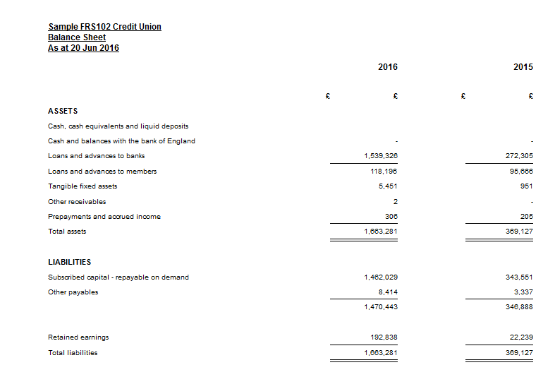
Balance sheet
FRS102 format
FRS102 Symposium
23 JUNE 2016
Manchester Conference Centre
Summer School 2016

Slide 28
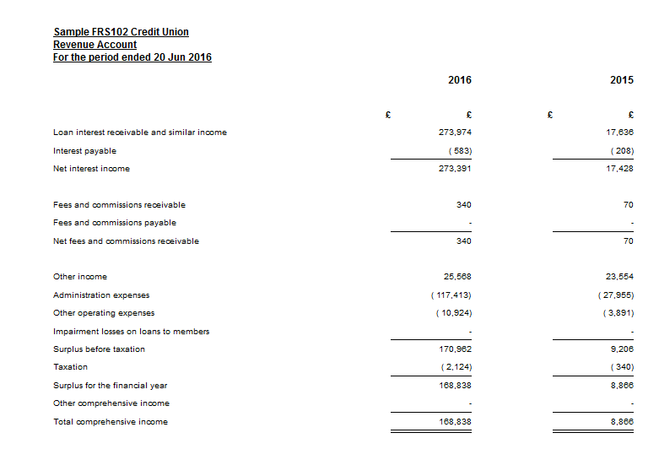
Revenue account
FRS102 format
FRS102 Symposium
23 JUNE 2016
Manchester Conference Centre
Summer School 2016

Slide 29
Getting ready for FRS102?
That’s the easy part – because there was already a ‘Balance sheet’ to convert.
There was also an existing ‘Revenue account’ to convert.
Even the mechanics of fixed asset register and schedule have been converted.
FRS102 Symposium
23 JUNE 2016
Manchester Conference Centre
Summer School 2016

Slide 30
Getting ready for FRS102?
However, the ‘Cash flow’ is new to most credit unions.
As is the credit risk analysis / impairment schedule.
And while we are at it we may as well consider the other notes to the accounts.
FRS102 Symposium
23 JUNE 2016
Manchester Conference Centre
Summer School 2016

Slide 31
Getting ready for FRS102?
The ‘Cash flow’ illustrates how changes in the Balance sheet and income affect cash¹
Unlike the two other statements this does not follow the coding plan route.
Therefore we need another way of finding the information to complete the Cash flow.
FRS102 Symposium
23 JUNE 2016
Manchester Conference Centre
1. Cash or cash equivalents
Summer School 2016

Slide 32
Getting ready for FRS102?
This is where we introduce a completely new program.
For those who don’t like housekeeping, this is not the most exciting task.
However, once completed, the result can be extremely satisfying.
FRS102 Symposium
23 JUNE 2016
Manchester Conference Centre
Summer School 2016

Slide 33
Getting ready for FRS102?
Introducing ‘Accounts format maintenance’ document creator.
This program is found under maintenance, nominal.
It is used to dart in and out of various locations picking up relevant information.
FRS102 Symposium
23 JUNE 2016
Manchester Conference Centre
Summer School 2016

Slide 34
Getting ready for FRS102?
Maintenance
Nominal
Accounts format maintenance
FRS102 Symposium
23 JUNE 2016
Manchester Conference Centre
Summer School 2016

Slide 35
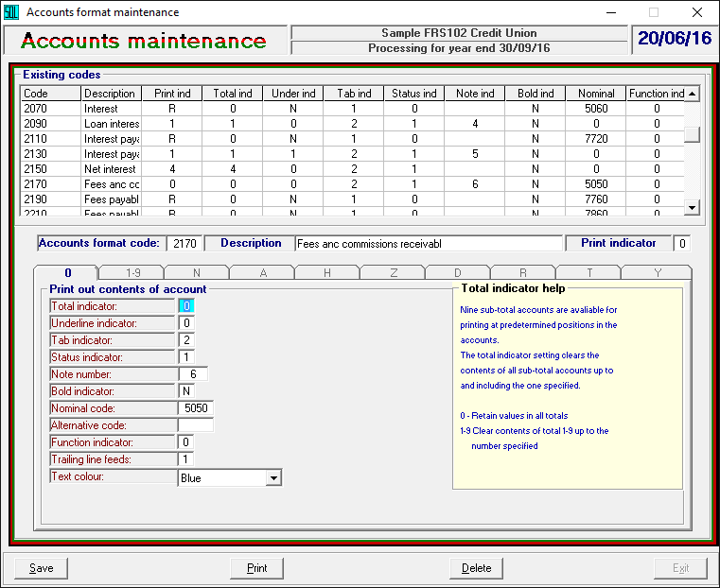
Getting ready for FRS102?
FRS102 Symposium
23 JUNE 2016
Manchester Conference Centre
Summer School 2016

Slide 36
Getting ready for FRS102?
Accounts format maintenance Operating instructions
FRS102 Symposium
23 JUNE 2016
Manchester Conference Centre
Summer School 2016

Slide 37
Getting ready for FRS102?
Since Kesho has no knowledge of nominal codes added by each credit union.
It is impossible to create a standard Statutory plan that will work for every CU.
Nevertheless Kesho may consider building a skeleton plan to give users a start.
FRS102 Symposium
23 JUNE 2016
Manchester Conference Centre
Summer School 2016

Slide 38
Getting ready for FRS102?
FRS102 Symposium
23 JUNE 2016
Manchester Conference Centre
Summer School 2016

Slide 39
Getting ready for FRS102?
What if the Board doesn’t want to change the layout of the nominal ledger?
That is where ‘Plan B’ comes in – The coding plan can stay as it is.
And the ‘Statutory’ file can control ‘Balance sheet’, ‘Revenue account’ and all ‘Notes’ .
FRS102 Symposium
23 JUNE 2016
Manchester Conference Centre
Summer School 2016

Slide 40
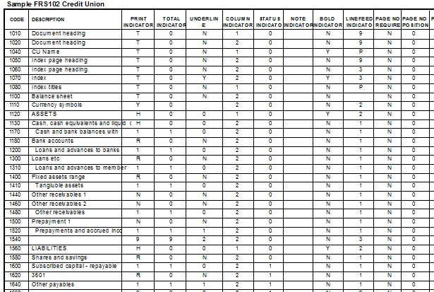
Getting ready for FRS102?
FRS102 Symposium
23 JUNE 2016
Manchester Conference Centre
Extract from statutory coding plan illustrating covering page and Balance sheet references
Summer School 2016

Slide 41
Getting ready for FRS102?
FRS102 Symposium
23 JUNE 2016
Manchester Conference Centre
Summer School 2016

Slide 42
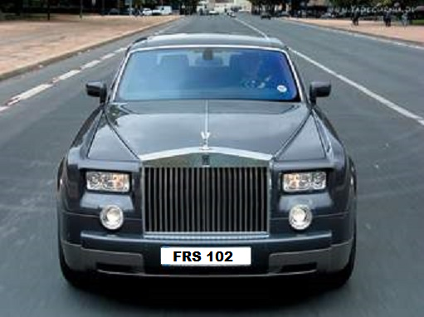
FRS102 Symposium
23 JUNE 2016
Manchester Conference Centre
Summer School 2016

