Slide 1
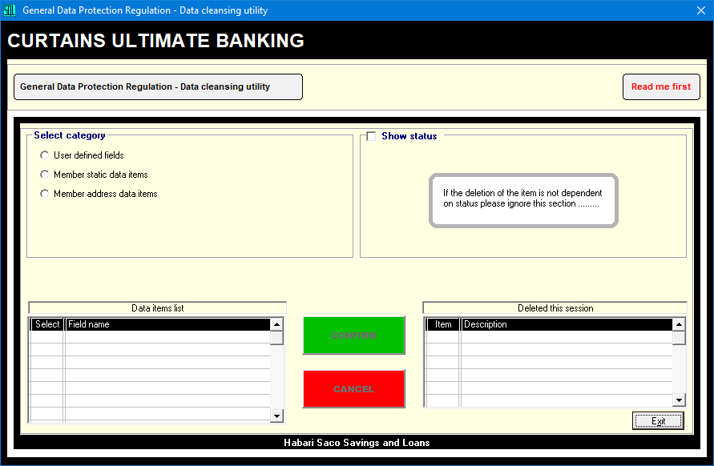
.

Slide 2
.
Introducing

Slide 3
.
G.D.P.R.

Slide 4
.
Data cleansing

Slide 6
As data will be permanently deleted you have to confirm acceptance of the disclaimer...

Slide 7
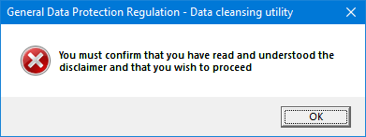
Unless you tick the box to confirm you cannot proceed to perform the utility actions………

Slide 8
Once you confirm acceptance of the disclaimer you can click ‘Hide’ to proceed ……………….

Slide 9
Certain items may be retained for future reference under GDPR (as illustrated above) ….

Slide 10
Checking this box will allow you to retain the specific items allowable under GDPR …………

Slide 11
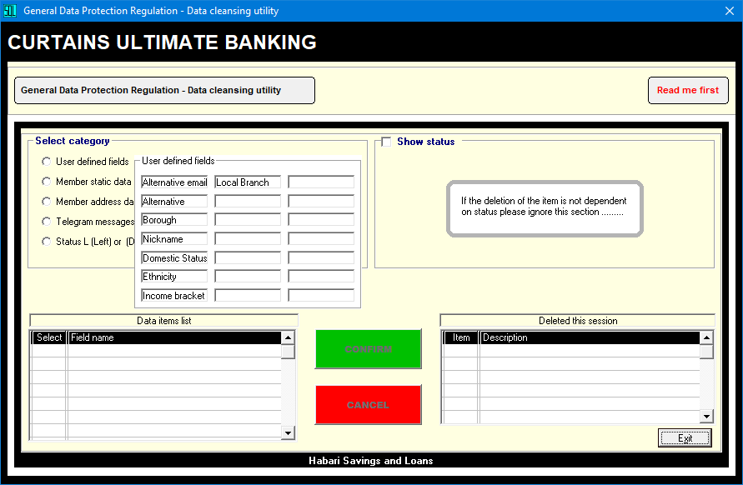
Hover over option buttons to view which fields can potentially be automatically erased ….

Slide 12
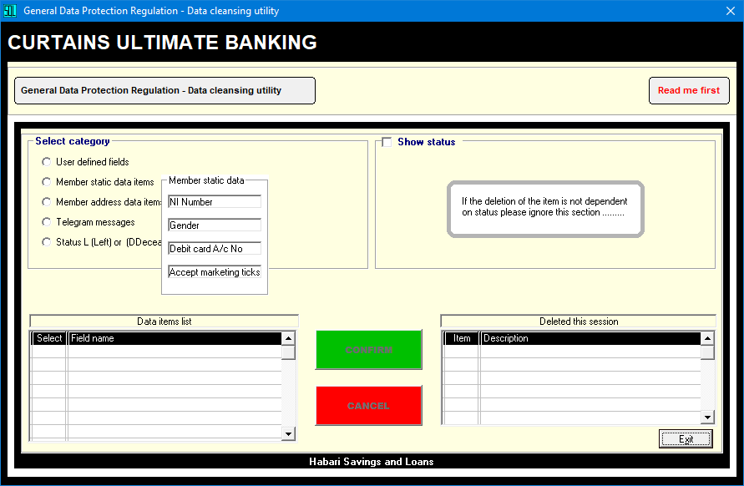
Hover over option buttons to view which fields can potentially be automatically erased ….

Slide 13
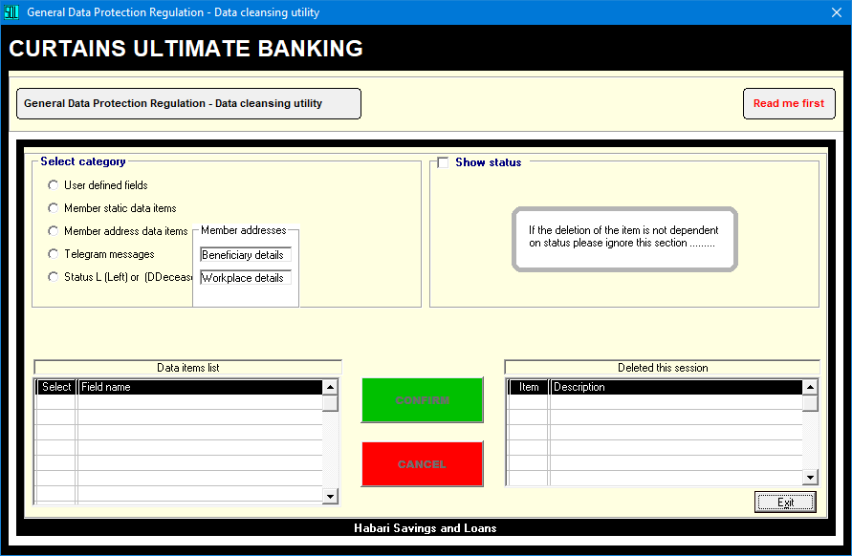
Hover over option buttons to view which fields can potentially be automatically erased ….

Slide 14
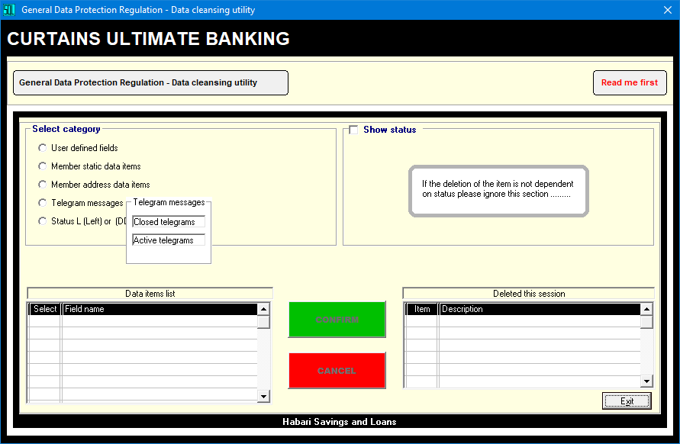
Hover over option buttons to view which fields can potentially be automatically erased ….

Slide 15
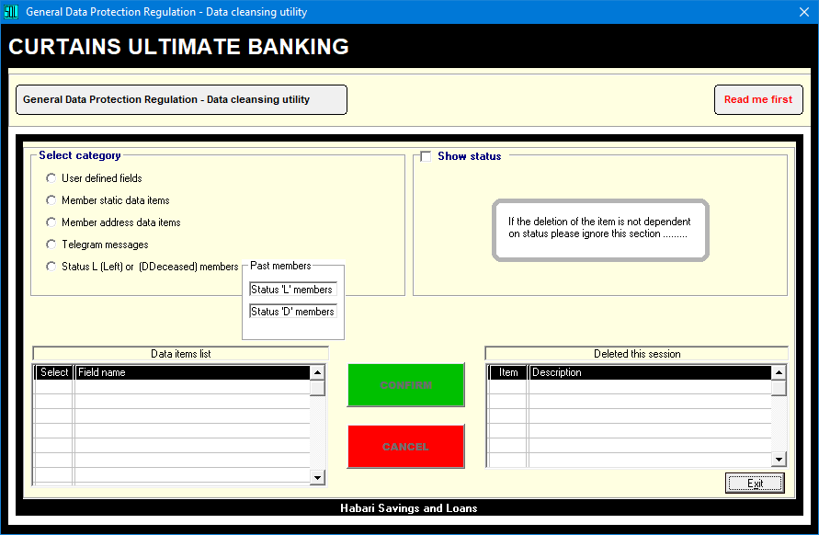
Hover over option buttons to view which fields can potentially be automatically erased ….

Slide 16
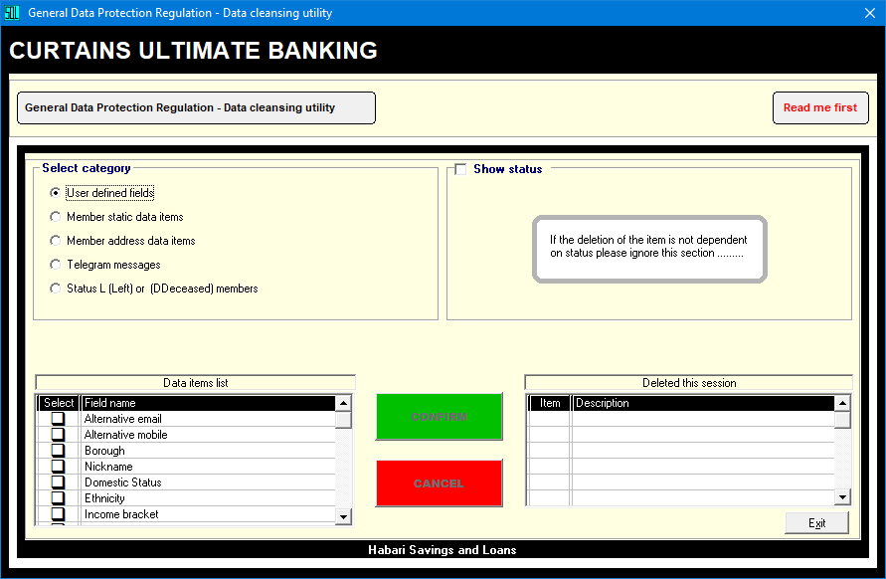
Click the appropriate option button to populate the data items listed on the left grid………

Slide 17
Select the item you wish to automatically delete by clicking the appropriate check box.….

Slide 18
You will notice that the command buttons ‘Confirm’ and ‘Cancel’ become enabled here….

Slide 19
If the required deletions apply to specific status codes , click here to reveal the keyboard..

Slide 20
ONLY click this checkbox if you wish to select specific status codes to affect the deletion..

Slide 21
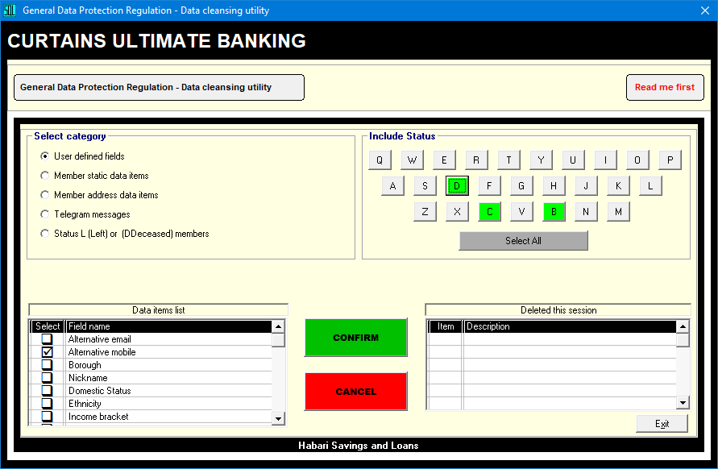
In this example we only want to delete UDF2 for members with status ‘B, ‘C’ or ‘D’ ………..

Slide 22
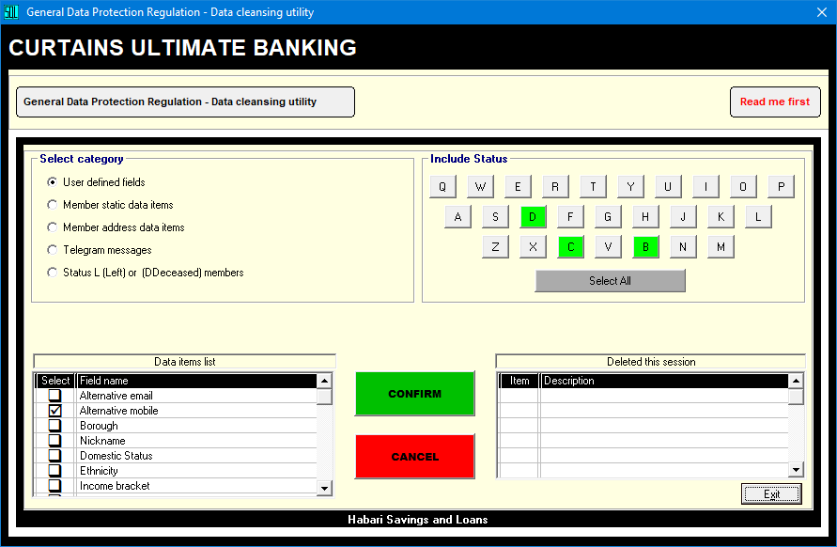
On clicking ‘Confirm’, don’t worry, you’ll still have an opportunity revert to Cancel later…

Slide 23
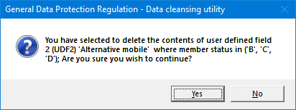
The first opportunity to CANCEL comes in the shape of a messge box (as shown above)…

Slide 24
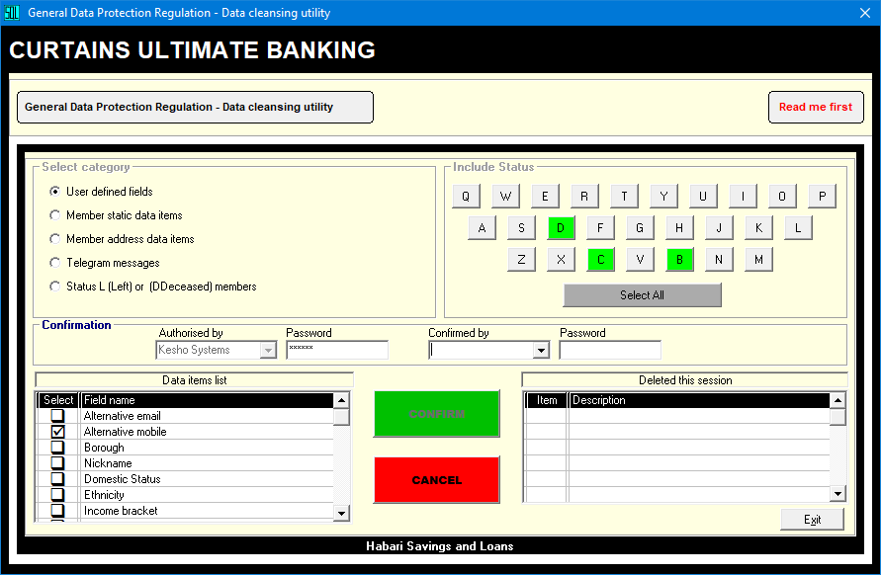
You must then ask a colleague with top priority level to further authorise the decision…….

Slide 25
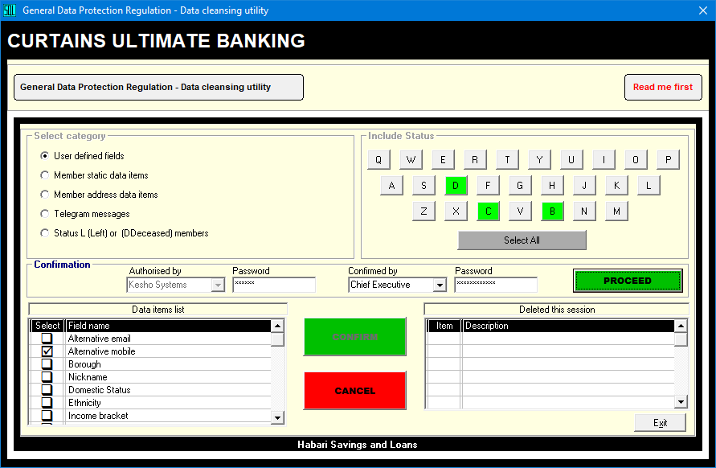
On successful entry of a top priority password, the ‘Proceed’ button will become visible…

Slide 26
On successful entry of a top priority password, the ‘Proceed’ button will become visible…

Slide 27
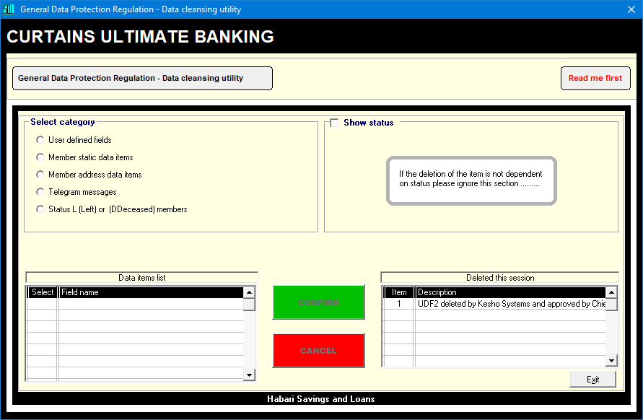
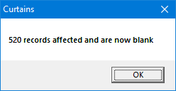
Where possible a message box, similar to that shown above, will confirm the success …

Slide 28
The selection you chose is deleted and a record appears in the session history grid ………..

Slide 29
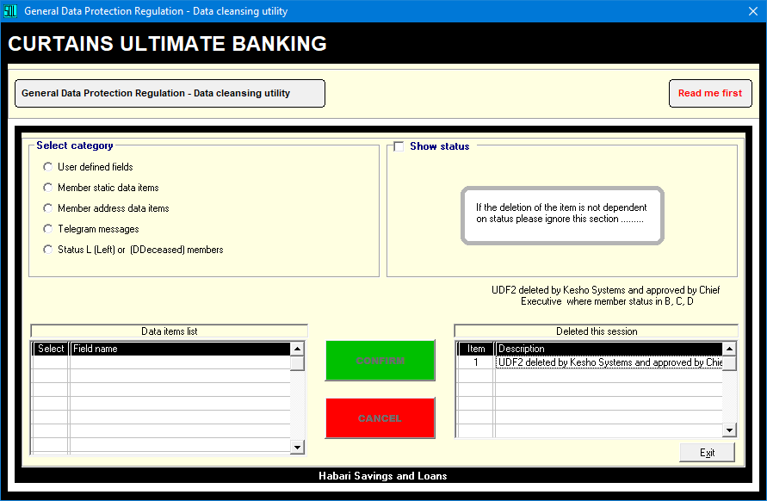
To view full description, simply click on the appropriate row on the grid as illustrated ……

Slide 30
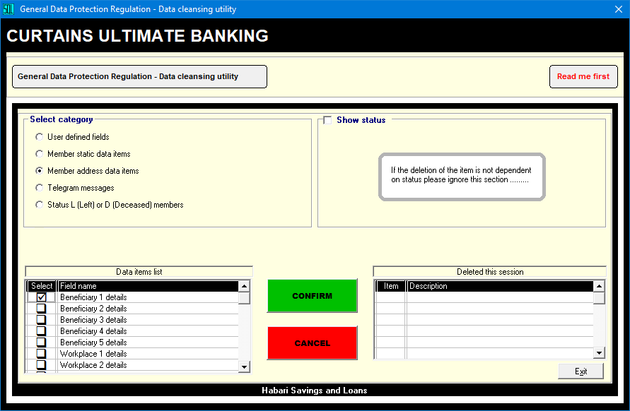
If you have selected one of the items with ‘optional’ retention of specific details then……

Slide 31
In this example ‘Beneficiary 1’ is selected, whereupon selected details may be retained…

Slide 32
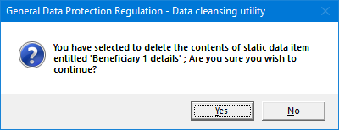
You must confirm that you wish to carry out a utility function on Beneficiary 1 details……

Slide 33
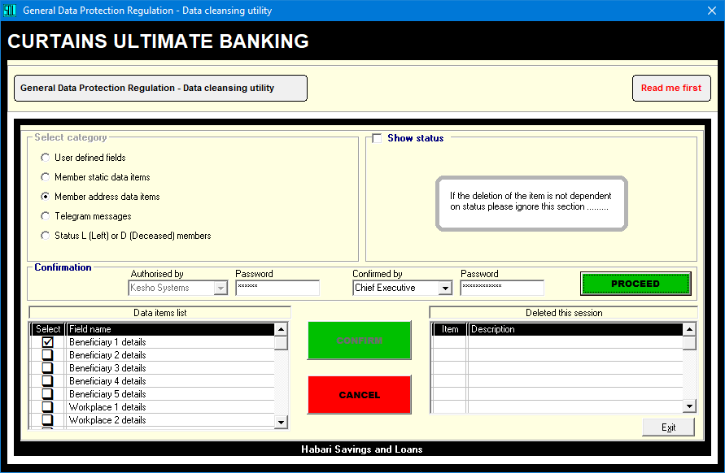
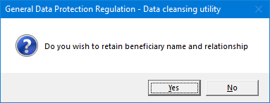
It is at this point that you must select whether or not you wish to retain some details……

Slide 34
If you have selected one of the items with ‘optional’ retention of specific details then……

Slide 35
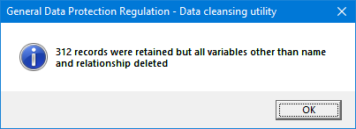
A message box explaining the action taken during this utility function appears as shown…

Slide 36
.

